Slide 1
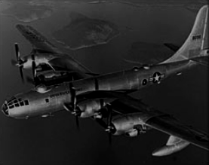
Puna Project Pitch 2023
By The Glider delivery group

Slide 2
Group members
Malachai -
Somewhat experienced with electronics
Fluent in programming
Peter -
Realist and programmer and designer
Aeroplane enthusiast
Has experience with flight simulators
Zafir -
Programmer and fashion modeller
Aeroplane enthusiast, fission engine builder

Slide 3
The problem
Delivering supplies to people in flooded areas as delivering supplies to people in flooded areas is very difficult due to lack of transport but it is vital for people to get their basic needs met.
Something that can deliver supplies safely to remote areas while using minimal power so that it is cheap and reliable.
Supplies are small converter/generators not the item itself. A solar generator creates electricity rather than a battery that runs out. A water purifier rather than water bottles. This means that continuous delivery is not needed but delivers something that is long lasting.
Link to website: Link

Slide 4
How?
A remotely controlled plane, with solar panels and wings for lift over speed.
Specially designed for streamlined package delivery.

Slide 5
What components? (Electronics)
x1 Cameras: Shows the surroundings to the remote pilot. Video stream.
x1 GPS: Where is the aeroplane? GPS Sends aeroplanes position.
x1 Accelerometer: What is the orientation? / velocity?
x1 Compass: compass
x1 DC Brushless motor
x1 CD Brushless motor controller
x5 Servos
x1 or x2 Propellor (Spare)
x1 Radio transmitter & receiver
x1 or x2 Camera
x1 micro controller (Pi Pico or Arduino Uno)
x1 Battery

Slide 6
How deliver package?
Packages are kept in fuselage storage space

Slide 7
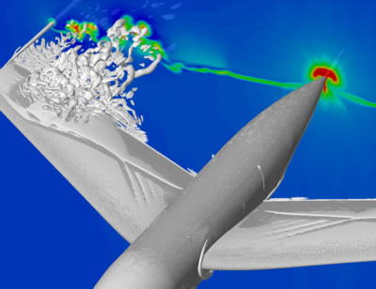
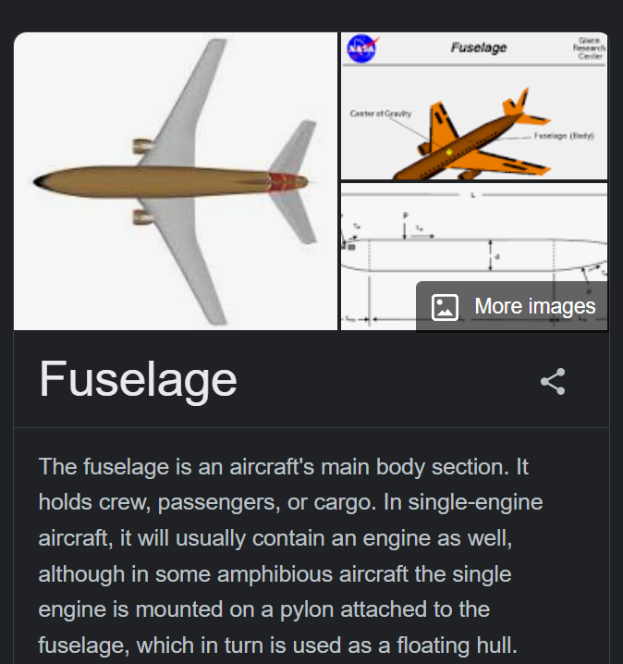
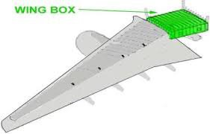
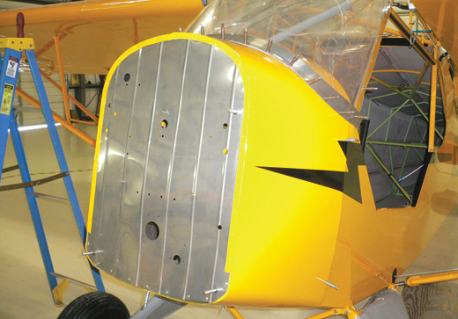
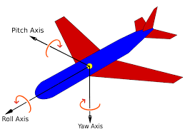

GLOSSARY
The wingbox of a fixed-wing aircraft refers to the primary load-carrying structure of the wing, which forms the structural centre of the wings and also the attachment point for other wing components such as leading edge flaps, trailing edge flaps and wing-tip devices.
The firewall is an important component in your aircraft. Essentially, it is a fire-resistant bulkhead that separates the engine compartment from the cockpit area. This special bulkhead must be constructed so that no hazardous quantity of liquid, gas or flame can pass through it.
Buffeting is a vibration of the aircraft that may appear during maneuvers at cruising speed. Depending on the angle of attack, the flow may contain separations, which constitute an aerodynamic excitation
The wingbox of a fixed-wing aircraft refers to the primary load-carrying structure of the wing, which forms the structural centre of the wings and also the attachment point for other wing components such as leading edge flaps, trailing edge flaps and wing-tip devices.

Slide 8
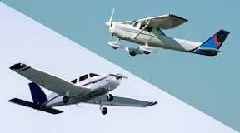
Wings: Big or Small? Aircraft: Fast or slow?
Lift = C_{L} * A * r * V²
C_{L} is lift coefficient
A is wing area
r is the density of air
V is the velocity
C_{L} is usually calculated experimentally with models in a wind tunnel.
Drag = C_{D} * A * r * V^2
C_{D} is drag coefficient
A is wing area
r is density of air
V is the velocity
C_{D} = C_{D0} + C_{L}^2 / ( π * A_{R} * e)
C_{D0} is the drag coefficient at 0 lift
C_{L} is the lift coefficient
A_{R} is the aspect ratio of the wing; A_{R}= L / W
L is length of wing (left-to-right)
W is width of wing (front-to-back
e is efficiency factor, e can be from 1 to 0, depends on the shape of the wing.
The density of the air is outside our control.
Area (A) and Velocity squared(V²) affect lift and drag proportionally, minimizing this to what is needed for lift will optimize for least drag.
C_{L} should be kept small since C_{L}² is proportional to drag and is C_{L} is proportional to lift.
A_{R} and e should be maximized to reduce drag from C_{L}².
How to affect C_{L} and e requires further analysis.
In summary, for minimum power consumption, a slow-flying aircraft with wings that are long(side to side) but short(front-to-back) is ideal.
Formulae source: NASA: Glenn Research Center

Slide 9

Which aerofoil?
After reading this webpage, we will use the SD7037 aerofoil as it's good for gliders.

Slide 10
Possibility: Solar panels
Glued solar wafers along wings and maybe some parts of fuselage. RC Flying Solar Plane

Slide 11
Motors: WHAT? How many? Where?
What motors?
We will use DC Brushless motors due to their efficiency and long lasting lasting. Source
There are some DC Brushless motors available at school to use.
A2212 / 10T
1400KV (1 Volt input makes 1400 turns)
1 Motor located on the nose

Slide 12
Propellers
How many propellor blades per motor?
2 and 4 propellers per blade are about the same efficiency, 4 blades uses more power to generate more thrust. 4 blades also reduces stress on blades by sharing load.
3 blades is a mystery.
Push prop vs pull prop:
Push prop bad use pull prop.source
How large should the blades be?
Big propeller blades generate more thrust for the same rotational speed compared to smaller blades. This is ideal for minimum power consumption.

Slide 13
Packages/Supplies, Shape? Size? Stored how?
horizontal storage VS vertical storage
Supplies are tightly packed into packages
Package shape/dimensions:
Cuboidal packages?
The plane drops cargo from underneath to minimize center of mass shifting when dropping.
Crank powered device: 128x60x50mm, 220g
Straw: 25x25x225mm, 57g,
Possible supplies: Lifestraw
Shake/Crank powered flashlight
Instructions pamphlet
Walkie talkie / radio
Dehydrated / vacuum sealed food (Space conservative)

Slide 14
Materials
Balsa Wood: main body
3D Printed: wings
Other options to consider:
coroplast sheets, fiberglass (Peter says nay), carbon fiber
Carbon Fiber is a polymer and is sometimes known as graphite fiber. It is a very strong material that is also very lightweight. Carbon fiber is five-times stronger than steel and twice as stiff.
Fiberglass is a common type of fiber-reinforced plastic using glass fiber. The fibers may be randomly arranged, flattened into a sheet called a chopped strand mat, or woven into glass cloth.
Coroplast sheets is short for corrugated plastic sheets

Slide 15
Shape and design
Body: Square tube, balsa wood, corflute
Prototyping with laser-cut card or corflute
Wings: Tutorial on modelling wings in Fusion 360 laser cutting or 3d printing.
Fuselage: laser cut frame with card for surface.

Slide 16
Transmitter and receiver
School supplied transmitter and receiver. FS-i6X
should work a decent distance and has 6 to 10 channels.
RF range: 2.408-2.475Ghz

Slide 17
Other details
Landing gear: Tricycle Gear (source: types of landing gears)

Slide 18
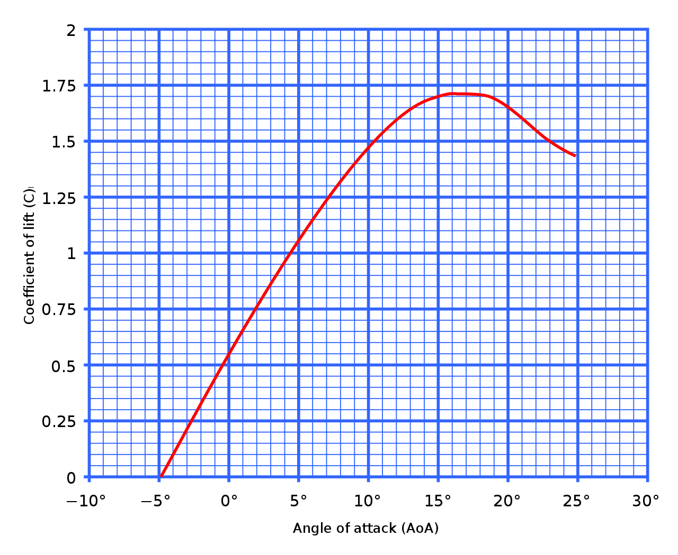
Calculations
See datasheet
Desmos wing graph

Slide 19
Controls (User interface on transmitter)
Pitch
Yaw
Throttle
Package Release

Slide 20
Coding
Servo - done
Accelerometer - doing
GPS - to do
Reciever - to do
Motor - to do
Compass - to do
Camera - to do

Slide 21
Solar
28x (78mm x 52mm dimensions) to fit on wings.
Each cell generates 0.5V so 28 cells will produce 14V.

Slide 22
Battery
Produces

